Slide 1
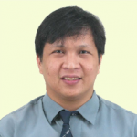
State of Research and Development in Biomedical Engineering in the Philippines
Engr. Voltaire B. Dupo, ECE
Compiled for IECEP AGM 2022

Slide 2
Notes and Disclaimers
Disclaimer:
The discussion that you will hear would be both based on what I have experienced from DLSU-IBEHT and the implementation of DOST-PCHRD funded projects at DLSU and published works relevant to the discussion and does not reflect the complete/full position of DLSU or IBEHT and DOST.
Note:
DLSU-IBEHT’s projects and events are supported by DOST-PCHRD.
For IECEP AGM 2022 by V. Dupo, ECE from IBEHT DLSU

Slide 3
Objectives
Understand what Biomedical Engineering really is all about.
State what area as Electronics Engineers do we likely occupy in the field of Biomedical Engineering.
Layout the Design Process in Engineering projects and how the design processing in R&D for Biomedical Engineering Research differs significantly.
Learn about the typical stages and evaluations used of development of medical devices.
Understand what support services exist in the current setup within the Philippines to aid in the development and registration of biomedical devices.
Enumerate the different projects that have been developed in the Philippines and used already as well on going projects.
For IECEP AGM 2022 by V. Dupo, ECE from IBEHT DLSU

Slide 4
Sections
Biomedical Engineering and Electronics Engineering a side by side comparison
Engineering Design vs Biomedical Engineering Design
Support Services that aid in Biomedical Engineering Research within the Philippines
Successful Projects in the Philippines
For IECEP AGM 2022 by V. Dupo, ECE from IBEHT DLSU

Slide 5
Biomedical Engineering and the education received to prepare to work in it.
Section I.
For IECEP AGM 2022 by V. Dupo, ECE from IBEHT DLSU

Slide 6
What is Biomedical Engineering?
The application of engineering principles, practices, and technologies to the fields of medicine and biology especially in solving problems and improving care (as in the design of medical devices and diagnostic equipment or the creation of biomaterials and pharmaceuticals (Merriam and Webster, 2022)
Biomedical Engineering was first used as a term in 1960 based on printed records.
involves applying the concepts, knowledge, and approaches of virtually all engineering disciplines (e.g., electrical, mechanical, and chemical engineering) to solve specific health care–related problems, the opportunities for interaction between engineers and health care professionals are many and varied. (Bronzino, 2012)
[Bronzino, 2012] Chapter 1 Section 3 - Biomedical Engineering: A Historical Perspective, Introduction to Biomedical Engineering (Third Edition), Joseph D. Bronzino, Academic Press, 2012, Pages 1-33, ISBN 9780123749796, https://doi.org/10.1016/B978-0-12-374979-6.00001-0.
[Merriam and Webster, 2022] “Biomedical engineering.” Merriam-Webster.com Dictionary, Merriam-Webster, https://www.merriam-webster.com/dictionary/biomedical%20engineering Accessed 3 Nov. 2022.
For IECEP AGM 2022 by V. Dupo, ECE from IBEHT DLSU

Slide 7
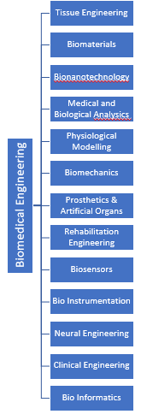
What is Biomedical Engineering?
[Bronzino, 2012] Chapter 1 Section 3 - Biomedical Engineering: A Historical Perspective, Introduction to Biomedical Engineering (Third Edition), Joseph D. Bronzino, Academic Press, 2012, Pages 18, ISBN 9780123749796, https://doi.org/10.1016/B978-0-12-374979-6.00001-0.
For IECEP AGM 2022 by V. Dupo, ECE from IBEHT DLSU

Slide 8
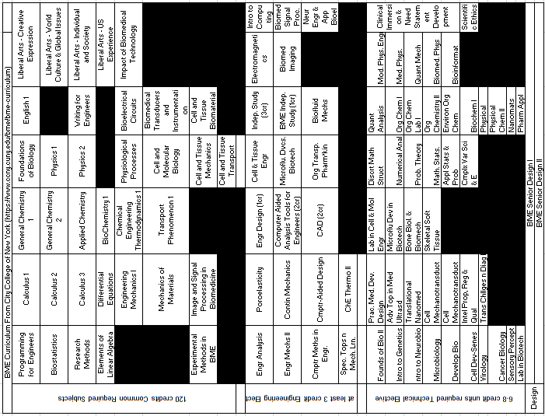
Sample Biomedical Engineering Program
For IECEP AGM 2022 by V. Dupo, ECE from IBEHT DLSU

Slide 9
Sample Biomedical Engineering Program
For IECEP AGM 2022 by V. Dupo, ECE from IBEHT DLSU

Slide 10
Sample Biomedical Engineering Program
For IECEP AGM 2022 by V. Dupo, ECE from IBEHT DLSU

Slide 11
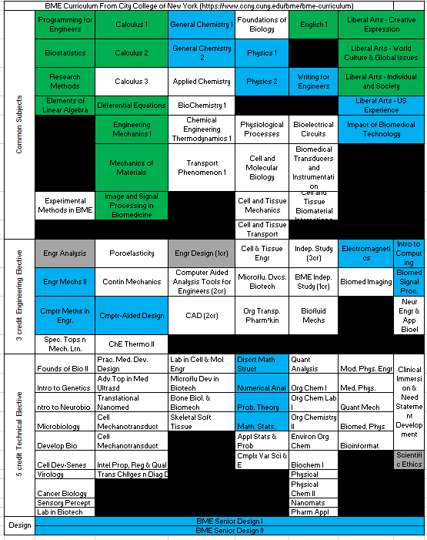
ECE Curriculum Overlayed on Sample BME Curriculum
For IECEP AGM 2022 by V. Dupo, ECE from IBEHT DLSU
Notes:
13 Core Subjects are missing
8 Subjects in Engineering Elective Covered
4 Subject in Technical Elective Covered
Science Ethics is covered but mixed with Laws and Norms of Practice

Slide 12
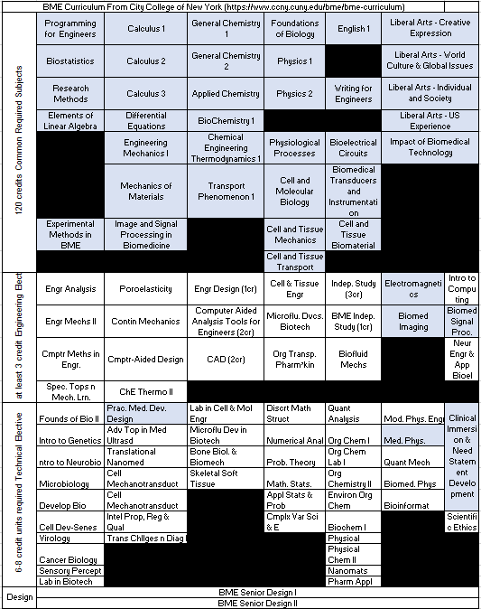
Clinical Engineering Pathway
For IECEP AGM 2022 by V. Dupo, ECE from IBEHT DLSU
Notes:
Missing 18 Core Subjects, 2 Engineering Electives, 3 Technical Electives

Slide 13
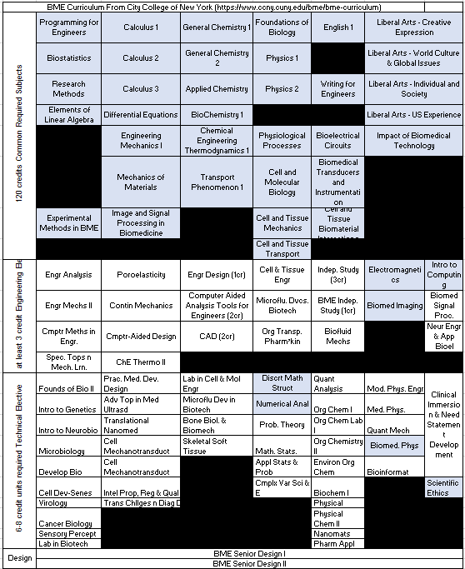
Medical Imaging Pathway
For IECEP AGM 2022 by V. Dupo, ECE from IBEHT DLSU
Notes:
Missing 18 Core Subjects, 2 Engineering Electives, 2 Technical Electives but Scientific Ethics may be required to be retaken

Slide 14
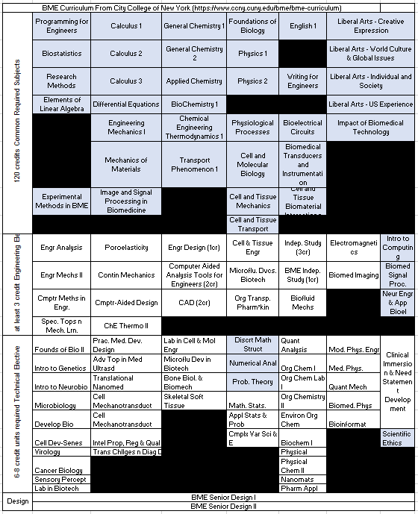
Vital Signs Monitoring Pathway
For IECEP AGM 2022 by V. Dupo, ECE from IBEHT DLSU
Notes:
Missing 18 Core Subjects, 2 Engineering Electives, 2 Technical Electives but Scientific Ethics may be required to be retaken

Slide 15
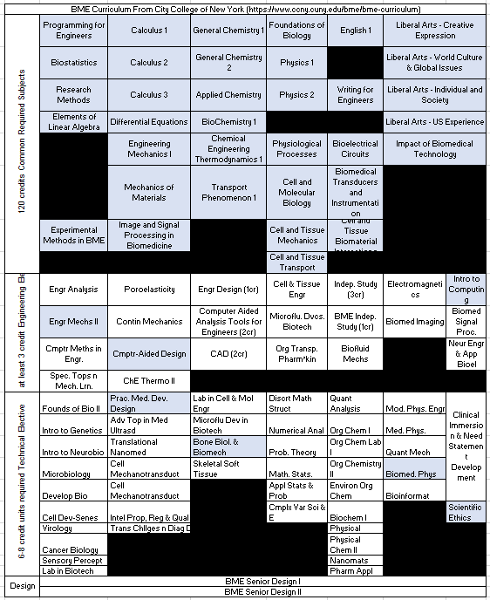
Research and Development Pathway
For IECEP AGM 2022 by V. Dupo, ECE from IBEHT DLSU

Slide 16
Review of the Design Process
Section II

Slide 17

Basic Design Process
Need for Product / Service
Problem Definition & Understanding
Research Preparation
Conceptualization
Synthesis
Evaluation
Optimization
Presentation
Chapter 3 Engineering Design Process, Engineering Fundamentals, Saeed Moaveni PP 41 – 46
For IECEP AGM 2022 by V. Dupo, ECE from IBEHT DLSU

Slide 18
Modified Design Process
Need for Product / Service
Problem Definition & Understanding
Research Preparation
Conceptualization
Synthesis
Evaluation
Optimization
Presentation
For IECEP AGM 2022 by V. Dupo, ECE from IBEHT DLSU

Slide 19
Team Members for Typical Engineering Project
Product Design and Development
Electronics Engineers / Industrial Engineers / Mechanical Engineers
Legal Department
Post Development - Business Side
Manufacturing Engineers
Marketing Department
Sales Department
For IECEP AGM 2022 by V. Dupo, ECE from IBEHT DLSU

Slide 20
Understanding the Issues with Existing Devices
Can be broken into issues with these on the right →
Idea Based on TRIZ
User / Customer related issues
Mass
Space
Solutions
Energy
Cost
For IECEP AGM 2022 by V. Dupo, ECE from IBEHT DLSU

Slide 21
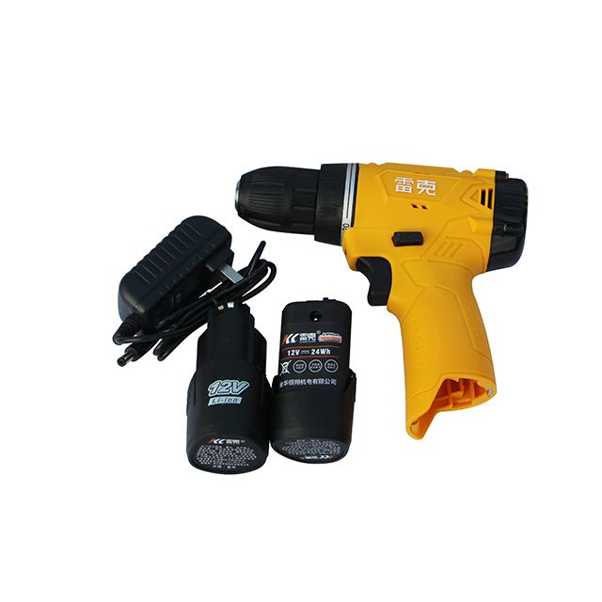
Example Non Medical Application
Problem Definition & Understanding
Mass
Too Heavy
Space
Too Large Profile
Energy
Low Operation Duration on a fully charged pack
Batteries die out faster than expected
Cost
Cannot match up with lower cost models from competitors
Ergonomics
Difficult to place into position or to hold for long duration
For IECEP AGM 2022 by V. Dupo, ECE from IBEHT DLSU

Slide 22
Questions for Non Medical Application
Conceptualization
What will it be used to drill into?
Wood
Metal
Concrete
Overall Mass of device
Overall Speed of Rotary End
Technology of Motor
Battery Management Module
For IECEP AGM 2022 by V. Dupo, ECE from IBEHT DLSU

Slide 23
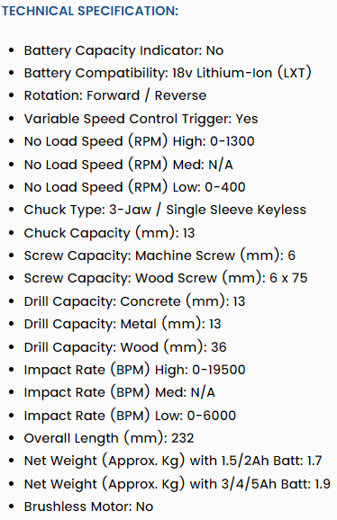
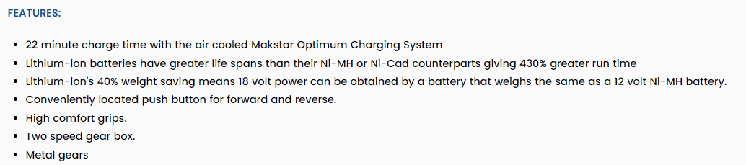
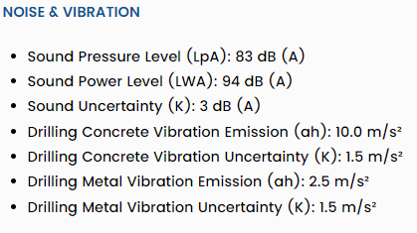
Outline of Product Specifications

Slide 24
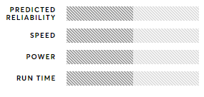
Consumer Evaluation
Evaluation
Performance when drilling different media
Battery Charger Performance Time to Full Charge
Specifications
Fully Assembled Mass
People Centered Activities like Focus Studies
For IECEP AGM 2022 by V. Dupo, ECE from IBEHT DLSU

Slide 25
Two Possible Directions in Biomedical Design Engineering
Biomedical Engineering
Science
Full Product
Technique
Materials
For IECEP AGM 2022 by V. Dupo, ECE from IBEHT DLSU

Slide 26
Modified Design Process
Need for Product / Service
Problem Definition & Understanding
Research Preparation
Conceptualization
Synthesis
Evaluation
Optimization
Presentation
For IECEP AGM 2022 by V. Dupo, ECE from IBEHT DLSU

Slide 27
Biomedical Engineering Design Process Full Product
Need for Product / Service
Team Members
Medical Team
Engineering Team
Design Team
Manufacturing Team*
Legal Department
IP Office
Data Privacy Office
Business Team
Problem Definition & Understanding
Research Preparation
Conceptualization
Synthesis
Evaluation
Chapter 3 Engineering Design Process, Engineering Fundamentals, Saeed Moaveni PP 41 – 46
Optimization
Presentation
For IECEP AGM 2022 by V. Dupo, ECE from IBEHT DLSU

Slide 28
Biomedical Engineering Design Process Science Side
Need for Product / Service
Team Members
Medical Team
Engineering Team
Design Team
IP Office
Legal Office *
Data Privacy Office *
Problem Definition & Understanding
Research Preparation
Conceptualization
Synthesis
Evaluation
Optimization
Presentation
For IECEP AGM 2022 by V. Dupo, ECE from IBEHT DLSU

Slide 29
Biomedical Engineering Design Process
Need for Product / Service
Assessment of Needs for the National Health / Research Goals & Funding Sources
Problem Definition & Understanding
Research Preparation
Conceptualization
Standards, Regulation and Physiological Factors
Synthesis
Supply Chain Consideration
Evaluation
Access to Equipment and Service Providers
Optimization
Value Engineering
Presentation
Device Certification and Registration
For IECEP AGM 2022 by V. Dupo, ECE from IBEHT DLSU

Slide 30
Assessment of Needs for the National Health / Research Goals & Funding Sources
Why:
Medical Device Development is not a short cycle development and usually requires a lot of investment on time and money to accomplish.
Being sure that your work can become something useful for the industry and society is of utmost importance.
Is it a solution that is needed now?
Is it a solution is existing? If yes what are the issues that are plaguing it?
Is it a solution that existing practitioners will buy and be on board to accept immediately or will it take time to convince everyone that it is a good idea or tool for a technique?
For IECEP AGM 2022 by V. Dupo, ECE from IBEHT DLSU

Slide 31
Assessment of Needs for the National Health / Research Goals & Funding Sources
Not Being on the sure side that it is needed
Waste your
Funds
Time
Can also tarnish your reputation.
For IECEP AGM 2022 by V. Dupo, ECE from IBEHT DLSU

Slide 32
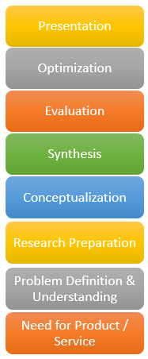


Alternative approach to the Design Process
Design Thinking
The inability of a design to consider human nature and human behavior the product ability to access the market or to be considered by the market as usable.
Considers Markets First Before engaging in any of the desired research and development activities first.
Test
Prototype
Ideate
Define
Empathize
V. Dupo
For IECEP AGM 2022 by V. Dupo, ECE from IBEHT DLSU

Slide 33
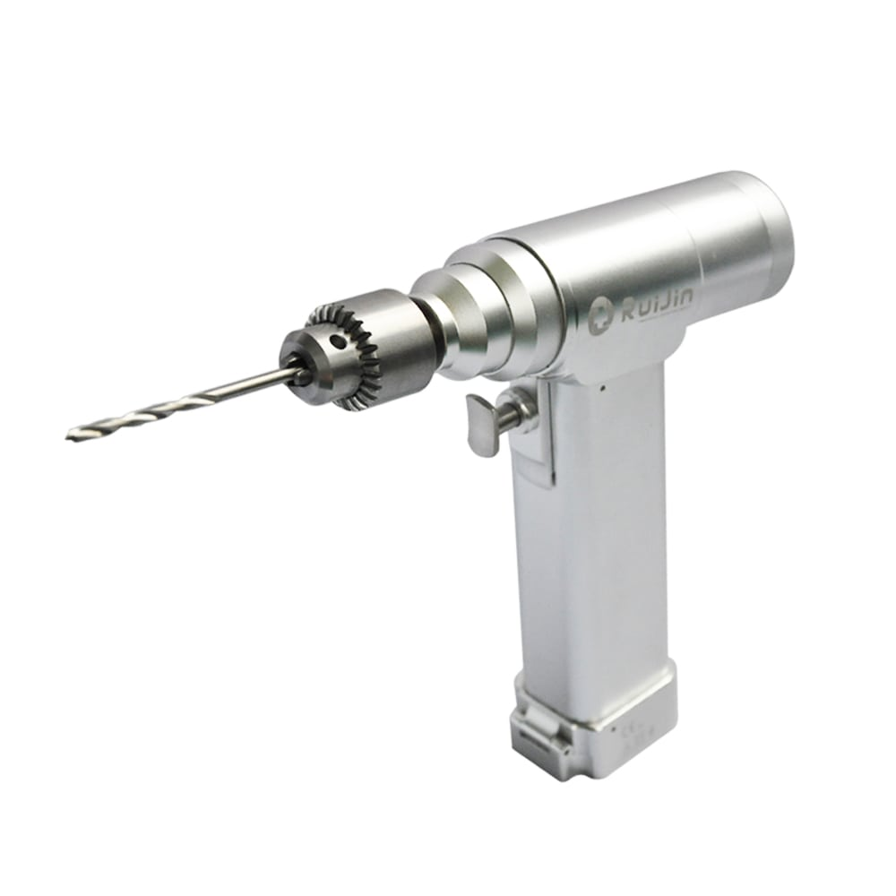

Example Investigation
Problem Definition & Understanding
Mass
Too Heavy
Space
Too Large Profile
Energy
Low Operation Duration on a fully charged pack
Batteries die out faster than expected
Cost
Cannot match up with lower cost models from competitors
Ergonomics
Difficult to place into position or to hold for long duration
Human Safety - does it perform to make the holes without damaging the underlying tissue too much?

Slide 34
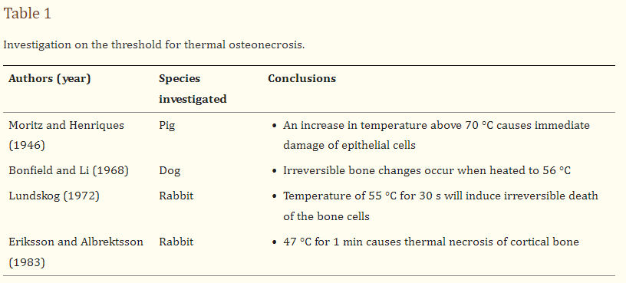
Items of Consideration for the Design
Problem Definition & Understanding
Conceptualization
Human Safety Aspect
Human Tissue is affected by temperature changes
Tissue near the hole made to die off when the tool is used
Under 47 degrees Celsius is the suggested limit based on table
10,000 RPM is the maximum limit to keep temperature under 47 Celsius Typically
Pandey RK, Panda SS. Drilling of bone: A comprehensive review. J Clin Orthop Trauma. 2013 Mar;4(1):15-30. doi: 10.1016/j.jcot.2013.01.002. Epub 2013 Jan 18. PMID: 26403771; PMCID: PMC3880511.
For IECEP AGM 2022 by V. Dupo, ECE from IBEHT DLSU

Slide 35
Example Investigation
Problem Definition & Understanding
Conceptualization
Mass
Too Heavy
Space
Too Large Profile
Energy
Low Operation Duration on a fully charged pack
Batteries die out faster than expected
Cost
Cannot match up with lower cost models from competitors
Ergonomics
Difficult to place into position or to hold for long duration
Human Safety - does it perform to make the holes without damaging the underlying tissue too much?
- How much stray current from motor is present in the machine?
For IECEP AGM 2022 by V. Dupo, ECE from IBEHT DLSU

Slide 36
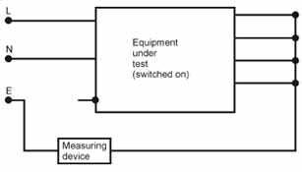
Items of Consideration for the Design
Problem Definition & Understanding
Conceptualization
Human Safety Aspect
Applied Current if any are measurable should be under 0.1mA in Normal Electrical Outlets (3 Prong) while 0.5mA in Special Function Electrical Outlets (3 Prong with RCD / GFCI).
Applicable only with Class I and II devices
For IECEP AGM 2022 by V. Dupo, ECE from IBEHT DLSU

Slide 37
Example Investigation
Problem Definition & Understanding
Conceptualization
Mass
Too Heavy
Space
Too Large Profile
Energy
Low Operation Duration on a fully charged pack
Batteries die out faster than expected
Cost
Cannot match up with lower cost models from competitors
Ergonomics
Difficult to place into position or to hold for long duration
Human Safety - does it perform to make the holes without damaging the underlying tissue too much?
- How much stray current from motor is present in the machine?
- Ability to work in Oxygen Rich Environments without introducing more Risk….
For IECEP AGM 2022 by V. Dupo, ECE from IBEHT DLSU

Slide 38
Item Considerations when dealing with Oxygen Rich Environments
Problem Definition & Understanding
Conceptualization
DC Motor
Has Arching between brush and commutator.
Reduction of Arching Achieved by Arc Suppression Circuits
Alternatives
Brushless Motors
Pneumatic Motors
For IECEP AGM 2022 by V. Dupo, ECE from IBEHT DLSU

Slide 39
Example Investigation
Problem Definition & Understanding
Conceptualization
Mass
Too Heavy
Space
Too Large Profile
Energy
Low Operation Duration on a fully charged pack
Batteries die out faster than expected
Cost
Cannot match up with lower cost models from competitors
Ergonomics
Difficult to place into position or to hold for long duration
Human Safety - does it perform to make the holes without damaging the underlying tissue too much?
- How much stray current from motor is present in the machine?
- Ability to work in Oxygen Rich Environments without introducing more Risk….
- Electro Magnetic Interference Compliant
For IECEP AGM 2022 by V. Dupo, ECE from IBEHT DLSU

Slide 40
Item Considerations when dealing with EMI Noise Compliant Device Requirement
Problem Definition & Understanding
Conceptualization
Heavy Shielding for Class III or ELV Equipment
DC Motor
Has Arching between brush and commutator.
Reduction of Arching Achieved by Arc Suppression Circuits
Brushless Motors
Fully Compliant Item if Powered by Air Hose Line
Pneumatic Motors
For IECEP AGM 2022 by V. Dupo, ECE from IBEHT DLSU

Slide 41
Performance and Compliance
Conceptualization
Synthesis
There is an aim to requires device to comply to a standard(s) / have conformity to a certain level of quality and performance
Recommendations from existing
Standards
Rules on Devices
Assessment of Needs for the National Health / Research Goals & Funding Sources
Standards, Regulation and Physiological Factors
Typically Considering as minimum full compliance to:
IEC 60601-1 (Medical Standard)
CISPR 11 Medical Device EM Compliance Standard
CISPR 14 Noise Immunity EM Compliance Standard
Supply Chain Consideration
Access to Equipment and Service Providers
Value Engineering
Device Certification and Registration
For IECEP AGM 2022 by V. Dupo, ECE from IBEHT DLSU

Slide 42
What if the solution developed is software?
Has to comply with ISO 62304:2006 – Medical device software
Needs to be evaluated based on software resiliency and immunity to hacking and have QC process to check accuracy.

Slide 43
Contracted Manufacturing
Synthesis
Some Parts may be difficult to produce in house or assemble as such Research Groups may enter into Contracts to Manufacture Parts or Sections of the Design
Usually requires
Non Disclosure Agreements between Research Group and Manufacturer
Site Inspection and Talks to determine ability of Manufacturer
Talks to determine pricing
Requires Inspection of Manufactured Part and Quality Checks Prior to Acceptance.
Redoing items should be part of the manufacturing contract if found to be sub- standard or non-compliant.
Manufacturers Selected may comply with at least
ISO 9001
Better if ISO 13485 but this is more costly specially for limited production runs for prototypes of 3-6 units only for evaluation purposes.
For IECEP AGM 2022 by V. Dupo, ECE from IBEHT DLSU

Slide 44


IP Protection
Initial run down of technology and evaluation of:
What is new or novel in the technology developed?
What is worth protecting?
Filling of Patents or Copyright Claims to protect the technology developed or Trademark Claims to protect developed product names.
Monitoring and Revising Submissions based on Feedback Received from Patent Office.
Synthesis
For IECEP AGM 2022 by V. Dupo, ECE from IBEHT DLSU

Slide 45
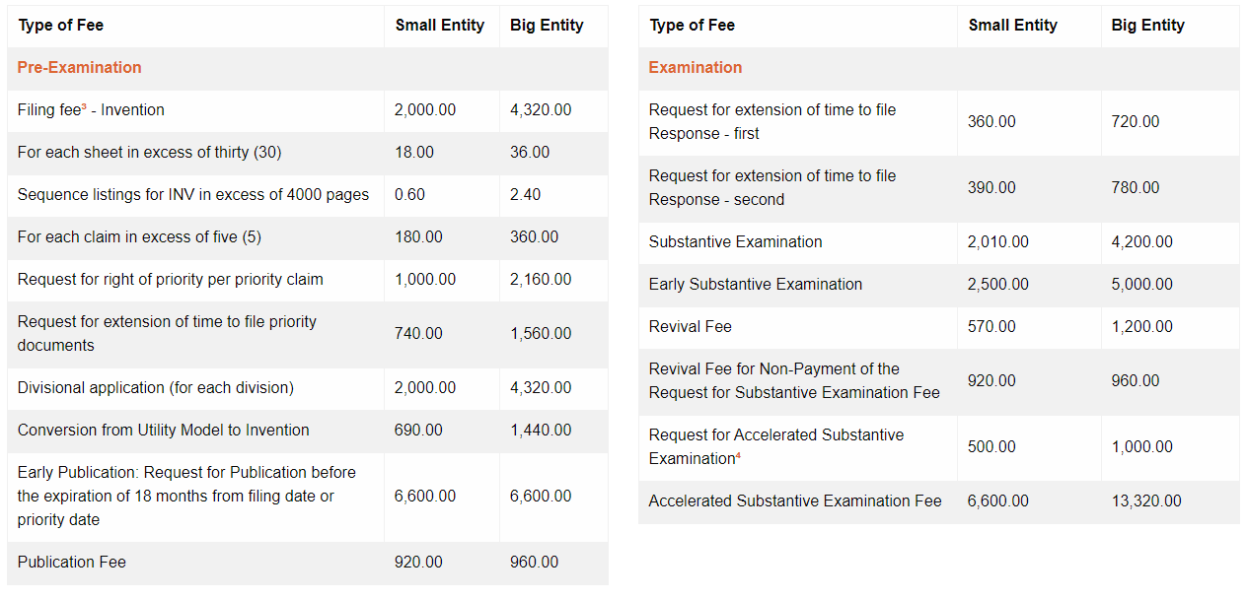
Patent Filing Costs
https://www.ipophil.gov.ph/services/schedule-of-fees/patents/

Slide 46
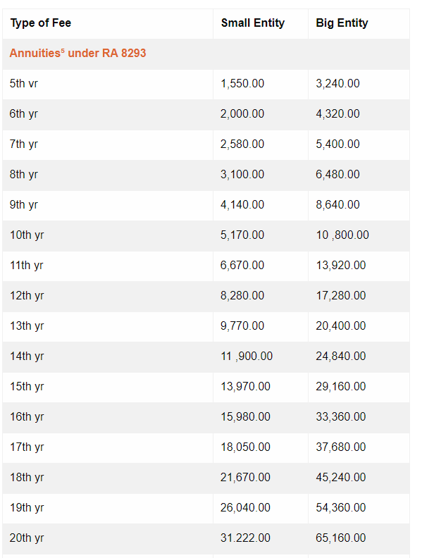
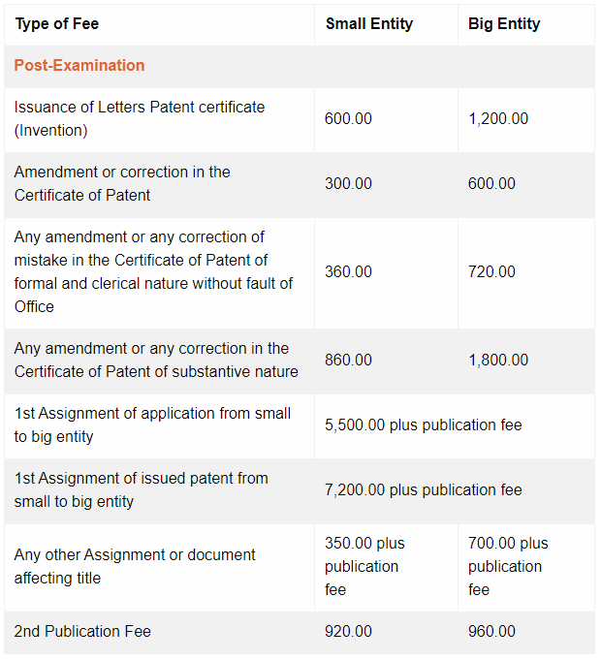
Patent Filing Costs
Table of Fees Source: https://www.ipophil.gov.ph/services/schedule-of-fees/patents/

Slide 47
Software Medical Device
Under Copyright typically
If hardware only runs on a particular software and process then it can be theoretically be included in the patent but this is very specific terms

Slide 48
To Publish or Not to Publish in Conferences? That is the Question
Terms and Conditions for Patents is that public disclosure should have not taken place x number of months prior to filling it.
Some require no disclosure at all prior to filling
EU System

Slide 49
Defending Patents and Copyright Claims
Requires a good lawyer / law firm to conduct
Requires money to spend to allow the legal process to go thru its paces.
Different Patents in Different Territories will require different law firms to conduct defense of patent rights.

Slide 50
Biomedical Engineering Design Process
Need for Product / Service
Assessment of Needs for the National Health / Research Goals & Funding Sources
Problem Definition & Understanding
Research Preparation
Preparing for Clinical Trials
Conceptualization
Standards, Regulation and Physiological Factors
Synthesis
Supply Chain Consideration
Evaluation
Access to Equipment and Service Providers
Technical Study
Optimization
Value Engineering
Presentation
Device Certification and Registration
Testing and Evaluation starts at the Assessment Stage of the project
For IECEP AGM 2022 by V. Dupo, ECE from IBEHT DLSU

Slide 51
Biomedical Engineering Design Process
Need for Product / Service
Assessment of Needs for the National Health / Research Goals & Funding Sources
Problem Definition & Understanding
Research Preparation
Preparing for Clinical Trials
Preparing for Clinical Trials
Conceptualization
Standards, Regulation and Physiological Factors
Synthesis
Supply Chain Consideration
Evaluation
Access to Equipment and Service Providers
Technical Study
Animal
Study
Optimization
Value Engineering
Presentation
Device Certification and Registration
It repeats for every different phase of evaluation

Slide 52
Biomedical Engineering Design Process
Need for Product / Service
Assessment of Needs for the National Health / Research Goals & Funding Sources
Problem Definition & Understanding
Research Preparation
Preparing for Clinical Trials
Preparing for Clinical Trials
Preparing for Clinical Trials
Conceptualization
Standards, Regulation and Physiological Factors
Synthesis
Supply Chain Consideration
Evaluation
Access to Equipment and Service Providers
Technical Study
Animal
Study
Human
Study
Optimization
Value Engineering
Presentation
Device Certification and Registration
Thus you can consider every testing activity as a phase in device development
For IECEP AGM 2022 by V. Dupo, ECE from IBEHT DLSU

Slide 53
Administration Coverage
Level 3 Ethics Review Board
Concern is primarily the welfare of participants in the scientific study to ensure that they are taken proper care for and are covered by the study proponents.
Reporting of Study Results and compliance is given to them at the end of every testing phase with live test subjects.
Philippine Food and Drug Administration
Concern is the effectivity of medical devices that are intended to be sold or marketed within the Philippine Economy
They are primarily concerned with scientific validity of the work done by medical equipment, manufacture of the item, after sales market support and surveillance as well as recalls.
For IECEP AGM 2022 by V. Dupo, ECE from IBEHT DLSU

Slide 54
Biomedical Engineering Design Process
Need for Product / Service
Assessment of Needs for the National Health / Research Goals & Funding Sources
Problem Definition & Understanding
Research Preparation
Preparing for Clinical Trials
Preparing for Clinical Trials
Preparing for Clinical Trials
Conceptualization
Standards, Regulation and Physiological Factors
Synthesis
Supply Chain Consideration
Evaluation
Access to Equipment and Service Providers
Technical Study
Animal
Study
Human
Study
Optimization
Value Engineering
Presentation
Device Certification and Registration
For IECEP AGM 2022 by V. Dupo, ECE from IBEHT DLSU

Slide 55
Technical Study
Personnel Requirement skills and experience for in House Evaluation Prior to any Third Party Evaluation
Test Engineer
Clinical Technology Management
Safety Officer
Orientation for personnel what will be helpful for proper documentation
Medical Device Development Record
Life Cycle Analysis
Pollution Control Training
Patent Clerk Training
Materials Compatibility
For IECEP AGM 2022 by V. Dupo, ECE from IBEHT DLSU

Slide 56
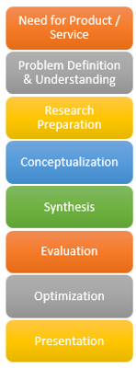
Technical Study
Evaluate the state of the medical device developed in compliance with
IEC 60601-1 Recommendations
Standard the Covers its performance parameters
This is usually done using a checklist with the specific passing values referenced to make a decision on pass or fail.
Preparing for Clinical Trials
This may require up to three or more
Revisions of the product before it
Goes to full compliance
Technical Study
For IECEP AGM 2022 by V. Dupo, ECE from IBEHT DLSU

Slide 57
Technical Study
Non Disclosure Agreements with Test Houses
Requires to prepare for agreements with external test houses and scheduling of testing.
Logistics to transfer equipment
Insurance to cover equipment during movement and personnel.
Payment agreement and terms with test houses
Preparing for Clinical Trials
This may require up to three or more
Revisions of the product before it
Goes to full compliance
Technical Study
For IECEP AGM 2022 by V. Dupo, ECE from IBEHT DLSU

Slide 58
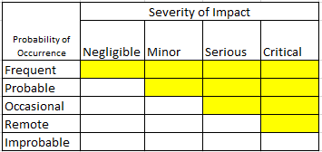
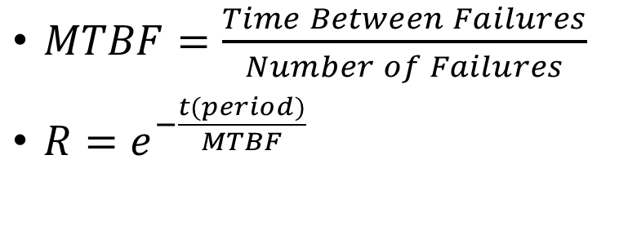
Technical Study
Risk Analysis
ISO 14971 outline how to quantify risk level for a medical device
Balance between Probability of Occurrence and Severity.
Machine Factor
Human Factor
Probability of Failure is estimated
In my case I use Weibull Analysis for a Quantitative Approach.
For IECEP AGM 2022 by V. Dupo, ECE from IBEHT DLSU

Slide 59
Technical Study
At the end of the Technical Study the following documents are produced
User Manual
Technical Manual
Medical Device Investigators Brochure
Includes Multiple Records of the HIRAC analysis of the device developed.
Test Evaluation Records and Certifications under Third Party Laboratories
Preparing for Clinical Trials
This may require up to three or more
Revisions of the product before it
Goes to full compliance
Technical Study
For IECEP AGM 2022 by V. Dupo, ECE from IBEHT DLSU

Slide 60
Technical Study
In House Tests
Traceable Certified and Calibrated Test Equipment must be used
Qualifications of Personnel using it should be also quantified and Traceable.
Testing Equipment Procured during Preparation Stage is used here.
Third Party Testing Houses
Traceable Entity Registration and Certification with International Accreditation Bodies
Traceable Issued Certifications
For IECEP AGM 2022 by V. Dupo, ECE from IBEHT DLSU

Slide 61
Technical Study
In House Tests
Traceable Certified and Calibrated Test Equipment must be used
Qualifications of Personnel using it should be also quantified and Traceable.
Third Party Testing Houses
Traceable Entity Registration and Certification with International Accreditation Bodies
Traceable Issued Certifications
For IECEP AGM 2022 by V. Dupo, ECE from IBEHT DLSU

Slide 62
`
Evaluation
Technical Study
Animal Studies
Human Studies
Testing
Passed?
Redesign
For IECEP AGM 2022 by V. Dupo, ECE from IBEHT DLSU

Slide 63
`
Evaluation For Science Side Project
Technical Study
Animal Studies
Human Studies
Testing
Passed?
Redesign
For IECEP AGM 2022 by V. Dupo, ECE from IBEHT DLSU

Slide 64
Animal Study
In most cases the machine can be used on animals that approximate the required physiology to check for effects / side effects of the machine.
General Considerations for Animal Studies for Medical Devices
(US FDA, https://www.fda.gov/media/93963/download )
Training on the Ethical Use of Lab Animals in Research (https://ritm.gov.ph/training/laboratory-training/training-on-the-ethical-use-of-lab-animals-in-research/ )
For IECEP AGM 2022 by V. Dupo, ECE from IBEHT DLSU

Slide 65
Animal Study
Animal | Area of Research Used in Traditionally
Dogs | Heart, Lungs, Kidneys
Monkeys | Human Behavior Studies
Mice | Almost All Processes plus Reproduction
Cats | Spine
Ferret | Disease and Drug Research
Pigs | Implantable Devices suchs as Pacemakers and dental implants
Rabbits | Reproduction and Exposure
Sheep | Respiratory System Related Research
Baboons | Skin Related Diseases and Treatments
Horses | Disease and Drug Research
*Studies that use animals undergo their own review system by a Committee created to ensure the proper
and humane treatment of animals that are contributing to understanding the dynamics and limitations of
devices or pharmaceutical products.
For IECEP AGM 2022 by V. Dupo, ECE from IBEHT DLSU

Slide 66
Animal Study
Requirements
Physical Plant and Support System is needed to run such activities such as:
Holding areas for animals
Personnel to take care of healthy animals
Procedure Areas
Personnel to ensure that animals used in studies receive proper care after the experiments have taken place.
Areas to hold animal remains before burial
Recommendation
Partner with an institution that conducts and has these type of facilities that fit your requirements and work with them to ensure that the protocols are compliant with the requirements set for this type of activity.
Preparing for Clinical Trials
Animal
Study
For IECEP AGM 2022 by V. Dupo, ECE from IBEHT DLSU

Slide 67
`
Evaluation
Technical Study
Animal Studies
Human Studies
Protocol Review & Partnerships
Partnership Done?
Yes
No
Testing
Protocol Approved?
Yes
Prepare for and Conduct Study
Yes
Passed?
No
Study Report
Compliance Report
Redesign
No
Passed?
For IECEP AGM 2022 by V. Dupo, ECE from IBEHT DLSU

Slide 68
Human Studies
All studies that use humans as sources of information are covered by:
Data Privacy Act
Good Clinical Practice
Preparing for Clinical Trials
Human Studies
For IECEP AGM 2022 by V. Dupo, ECE from IBEHT DLSU

Slide 69
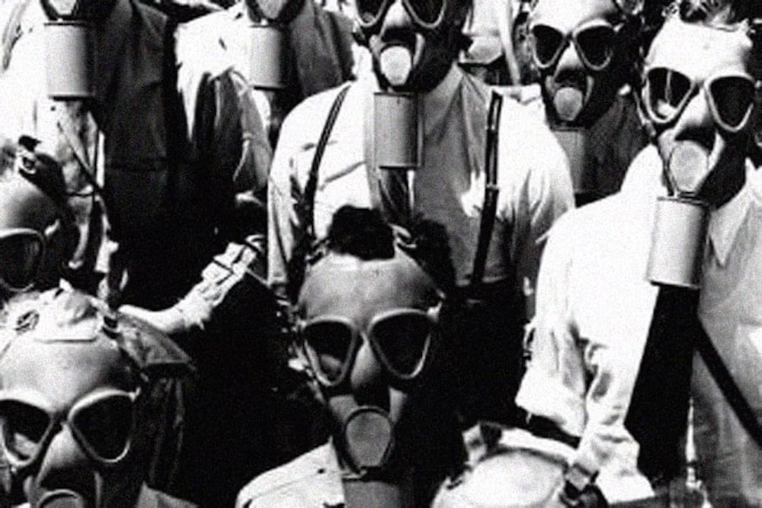
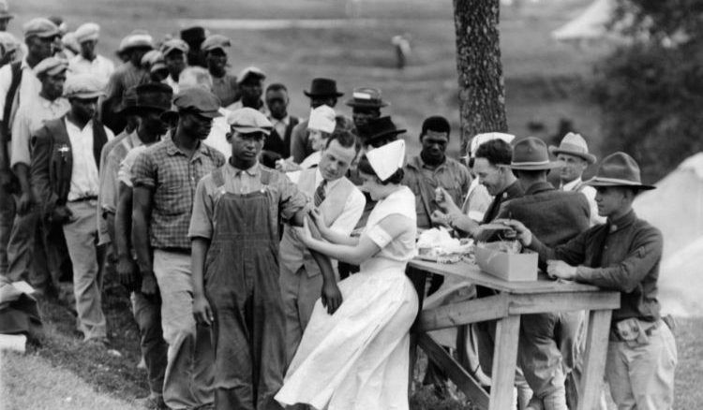
Human Experiments conducted in the Past
Tuskegee, Alabama Experiments on Sphyllis
US Navy Experiments on Effects of Mustard Gas and
Image Source:
Article Reference: https://www.cdc.gov/tuskegee/timeline.htm
Article Reference: https://www.smithsonianmag.com/smart-news/americans-who-were-exposed-mustard-gas-wwii-experiments-180957152/

Slide 70
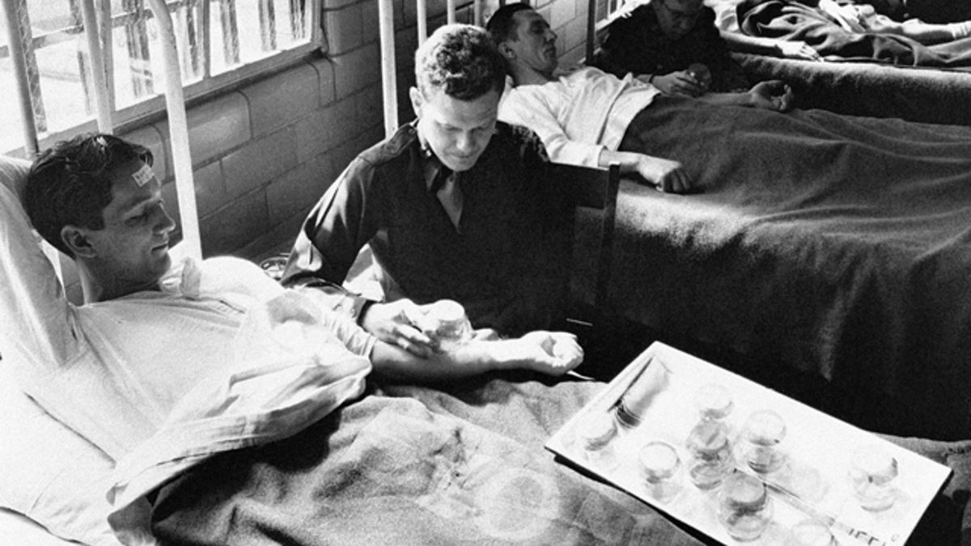
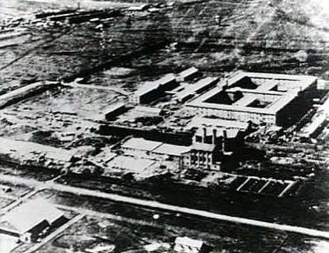
Human Experiments conducted in the Past
The Stateville Penitentiary Malaria Experiments
Unit 731 Human Experiments
Miller, Franklin G. (2013). The Stateville Penitentiary Malaria Experiments: A Case Study in Retrospective Ethical Assessment. Perspectives in Biology and Medicine, 56(4), 548–567. doi:10.1353/pbm.2013.0035
https://unit731.org/
Notes:
Unit 731 was involved in Plague and Anthrax Research involving live humans
Stateville Penitentiary Experiments where legally done but the way the study was done leaves issues on the welfare of the participant as well as the type of participant used in the study

Slide 71
Human Studies GCP
1. An Introduction to Clinical Research
2. An Overview of ICH GCP
3. Code of Federal Regulations
4. FDA 21 CFR
5. Sponsors Responsibilities
6. Investigators Responsibilities
7. Investigators Responsibilities
– Informed Consent Form
8. Reporting Responsibilities of the Investigators
9. Ethics of Research Involving Children
10. Ethics of Research Involving Mentally Incapacitated
11. Ethics of Research Involving Pregnant Women and Fetuses
12. Ethics of Research Involving Prisoners
13. Trial Management – Data Handling and Record Retention
14. Adverse Events
15. Safety of Human Subjects in Clinical Research
a) Common Terminology Used In Clinical Research
b) Commonly Used Abbreviations and Terms in Clinical Research

Slide 72
Human Studies
Human Studies directly apply the machine to people and is required by law to be covered by a Protocol Review and Approval Process
Staff who will conduct the research on this end are required to have Certification on Good Clinical Practice to understand what is important in conducting an ethical scientific inquiry using actual human beings.
Protocols are written as drafts during the Research Preparation stage.
Protocols are revised and reviewed after the technical study concludes
Preparing for Clinical Trials
Human Studies
For IECEP AGM 2022 by V. Dupo, ECE from IBEHT DLSU

Slide 73
Human Studies
Determination of the Type of Study to be conducted
To Establish a level of safety for human use.
Validation of Physiological Effects
Validation of Efficacy for Specific types of treatments.
Preparing for Clinical Trials
Human Studies
For IECEP AGM 2022 by V. Dupo, ECE from IBEHT DLSU

Slide 74


Revision of Design Process
Technical Study Phase 0
Animal Studies Phase 1
One Phase
Human Safety Study Phase 2
Human Efficacy Study Phase 3
For IECEP AGM 2022 by V. Dupo, ECE from IBEHT DLSU

Slide 75
Human Studies
Document | Technical | Medical | Legal | IP | Data Privacy
Protocol Document | x | x | x |  | x
Informed Consent Document |  | x | x |  | X
Proof of Liability Insurance | x | x | x |  | X
Proof of Medical Insurance for Participants | x | x |  |  | x
Medical Device Brochure | x | x |  | x
CV of Investigators | x | x
Copies of Past Investigations conducted with the device in its present configuration. | x | x | x | x | x
User and Technical Manuals | x | x | x | x
For IECEP AGM 2022 by V. Dupo, ECE from IBEHT DLSU

Slide 76
Human Studies
Submissions for Protocol Review are done with an Ethics Review Board of your choosing.
Typically one that the primary medical investigator recommends
Area where the study is conducted
Availability of Level 3 Research Ethics Board
Submissions include
Letter of Intent
Protocol Document
Informed Consent Document
Proof of Liability Insurance
Proof of Medical Insurance for Participants
Medical Device Brochure
CV of Investigators
Copies of Past Investigations conducted with the device in its present configuration.
User and Technical Manuals
Preparing for Clinical Trials
Human Studies
For IECEP AGM 2022 by V. Dupo, ECE from IBEHT DLSU

Slide 77
Human Studies
Ethics Board Approval can take months or years depending on the extent of work to be done.
Set of objectives that are concise and specific need to be arranged before hand on the written protocol
Makes things easier to understand
Make it faster to see the risks
Faster to outline control structures in place to reduce or remove these risks.
Preparing for Clinical Trials
Human Studies
For IECEP AGM 2022 by V. Dupo, ECE from IBEHT DLSU

Slide 78
`
Evaluation Full Process
Technical Study
Animal Studies
Human Studies
Insurance, Site Agreements, Protocol Writing
Protocol Review & Partnerships
Partnership Done?
Preparation Complete?
No
Revisit General Plan to determine next step
Yes
No
Yes
Testing
Protocol Approved?
Yes
Submit Protocol for Ethics Board Review
Prepare for and Conduct Study
Yes
Reports
Yes
No
Study Report
Passed?
Passed?
Protocol Approved?
No
No
Study Report
Compliance Report
Yes
Prepare for and Conduct Study
Compliance Report
No
Redesign
No
Passed?
Yes
Technical Issue?
For IECEP AGM 2022 by V. Dupo, ECE from IBEHT DLSU

Slide 79
`
Evaluation Full Process
If No Animal Model
Exists or no Simulated
Model Exists to take
Its place
Technical Study
Human Studies
Insurance, Site Agreements, Protocol Writing
Preparation Complete?
No
Revisit General Plan to determine next step
Yes
Testing
Submit Protocol for Ethics Board Review
Yes
Reports
Yes
No
Study Report
Passed?
Passed?
Protocol Approved?
No
No
Yes
Prepare for and Conduct Study
Compliance Report
No
Redesign
Yes
Technical Issue?
For IECEP AGM 2022 by V. Dupo, ECE from IBEHT DLSU

Slide 80

Revision of Design Process
Prototypes
Commercially Viable Product
Technical Study Phase 0
Animal Studies Phase 1
Human Safety Study Phase 2
Human Efficacy Study Phase 3
For IECEP AGM 2022 by V. Dupo, ECE from IBEHT DLSU

Slide 81
Value Engineering
Revision of the Product to address any of the four (4) areas in engineering
Mass
Space
Solutions
Energy
Cost
For IECEP AGM 2022 by V. Dupo, ECE from IBEHT DLSU

Slide 82
Value Engineering
Can be used as a enabling Pathway towards Mass Manufacturing for the device
10 – 100 Units
Mass
Space
Solutions
Energy
Cost
For IECEP AGM 2022 by V. Dupo, ECE from IBEHT DLSU

Slide 83
Value Engineering
Value Engineering can be done on parts or the whole device itself.
The price also changes depending on
Coverage of work.
Simple part replacement vs System Re-design
Patent Ownership Rights as Assignee
Mass
Space
Solutions
Energy
Cost
For IECEP AGM 2022 by V. Dupo, ECE from IBEHT DLSU

Slide 84
Added Engineering if Left Undone during Design Phase
Manufacturability
Process
Sterilization
Device
Assembly Process
Quality Control
Packaging
Compliance with Manufacturing Guidelines
ISO 13485
For IECEP AGM 2022 by V. Dupo, ECE from IBEHT DLSU

Slide 85
Administration Coverage
Technical Study Phase 0 (Laboratory Test Bench Studies and 3rd Party Tests)
Ethics Review Board
Level 3
Animal Studies Phase 1 ( 1 Study Site)
Human Safety Study Phase 2 (1 Study site)
Value Engineering (10 – 100 Units)
FDA and Ethics Review Board
Human Efficacy Study Phase 3 (Multiple Sites)
Spin Off - Commercialization
For IECEP AGM 2022 by V. Dupo, ECE from IBEHT DLSU

Slide 86
Administration Coverage
Technical Study Phase 0
(1 Unit minimum)
Ethics Review Board
Level 3
Animal Studies Phase 1
( 2 Units)
Human Safety Study Phase 2
(2 Units / Study Site)
FDA and Ethics Review Board
Value Engineering (10 – 100 Units)
Human Efficacy Study Phase 3 (Multiple Study Sites)
(3 Units / Study Site)
For IECEP AGM 2022 by V. Dupo, ECE from IBEHT DLSU

Slide 87
My own experience on this activity
Agapay Project
Description of Device
Standards Covered by Technical Study
IEC 60601-1
CISPR 11 & 21
IEC 80601-1-72
RIA 14 Recommendations on Robots working in Close Proximity with Humans
NIRP 1998 Recommendations
Regional Recommendations
Asean Medical Directive
ISO 14971
ISO 14155

Slide 88
Support System for Biomedical Research
Section III.
For IECEP AGM 2022 by V. Dupo, ECE from IBEHT DLSU

Slide 89
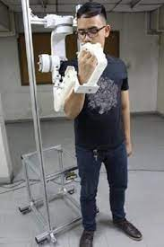
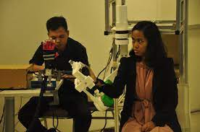
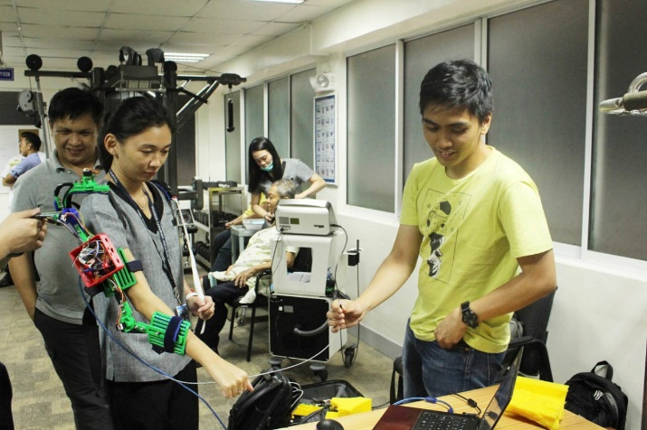
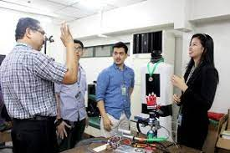
This Section III contains names of companies that are important for the projects that I worked on. But there possibly more companies that cater to it.
Authors Notes
For IECEP AGM 2022 by V. Dupo, ECE from IBEHT DLSU

Slide 90
`
Support Systems for BME Research and Development
 | In House Teams Medical, Engineering, Legal, IP, Data Privacy
For IECEP AGM 2022 by V. Dupo, ECE from IBEHT DLSU

Slide 91



`
Support Systems for BME Research and Development
Initial Funding for Project and Prototype Creation
For IECEP AGM 2022 by V. Dupo, ECE from IBEHT DLSU

Slide 92



`
Support Systems for BME Research and Development
IP Protection
For IECEP AGM 2022 by V. Dupo, ECE from IBEHT DLSU

Slide 93








`
Support Systems for BME Research and Development
Suppliers for Equipment and Parts
Fabricators
For IECEP AGM 2022 by V. Dupo, ECE from IBEHT DLSU

Slide 94


`
Support Systems for BME Research and Development
In House Test Equipment – EST, EM Radiation Survey Tools
Standard Testing Provider
For IECEP AGM 2022 by V. Dupo, ECE from IBEHT DLSU

Slide 95
BME Projects in the Philippines
Section 4.

Slide 96
BME Projects in the Philippines
Swifter | Ateneo Research Institute for Science and Engineering | Ms. Marie Jennifer V. Reolo, MSc. | Covid-19 Testing LAMP Assay
CRISPR-Dx | UP Diliman - National Institute of Molecular Biology and Biotechnology | Dr. Ron Leonard V. Dy | Development of diagnostic kits that can detect relevant infectious diseases.
CHERISH Study | The Medical City | Dr. Beatrice Tiangco | AI-Powered Reading of Chest X-rays in Diagnosis of COVID-19 Pneumonia in Tertiary Hospital
Sanipod: Self-contained disinfecting Cubicle |  | Dr. Edward Wang | Disinfection for healthcare workers
Cleanintubate |  | Dr. Catherine Co. | Laryngoscope Blades Disinfection Machine

Slide 97
BME Projects in the Philippines
RxBox |  | Dr. Geohari Hamoy | Telemetry system for COVID-19
MyBeshie: Bot Ensuring Safety and Health in Isolated Environment |  | Dr. Nathaniel Orillaza | Telepresence Terminals to aid in COVID-19 Response
LISA Robot | University of Santo Tomas | Dr. Anthony James Bautista | Remote controlled Robot employed to operate mundane but important taks lessening exposure of health care workers in a hospital setting.
E-steth |  | Dr. Michelle Cristine Miranda | Acoustic - Electronic Stethoscope that allows health workers to listen at a safe distance to breathing sounds

Slide 98
BME Projects in the Philippines
SiglaVent. | Technological Institute of the Philippines | Engr. Joel John Martinez | Automated Ambu-bag with ventilator features for emergency use
 | University of San Carlos Cebu | Dr. Edward Querikiol | Low Cost Ventilation system in tropical regions for risk reduction of infectious aerosol and virus transmission
Lapara Project | Institute of Biomedical Engineering and Health Technologies - DLSU | Dr. Nilo Bugtai | Robotic and Articulating Laparascope instrument for surgeons that is easy to use and maneuver.
Agapay Project | Institute of Biomedical Engineering and Health Technologies - DLSU | Dr. Renann Baldovino | Wearable Robotic Exoskeleton that provides motor rehabilitation and physical therapy for post stroke and injured patients

Slide 99
BME Projects in the Philippines
TAYO Project | Institute of Biomedical Engineering and Health Technologies - DLSU | Dr. Armyn Sy | Multi-functional rehabilitation device for early mobilization initially designed to rehabilitate stroke patients.
Kandili | Institute of Biomedical Engineering and Health Technologies - DLSU | Atty. Christopher Cruz | Development of a Competitive Intellectual Property Management System to Effectivity and efficiently facilitate commercialization of biomedical devices and health technologies
Capacita | Institute of Biomedical Engineering and Health Technologies - DLSU | Atty. Christopher Cruz | Equip Researchers, Inventors, Technology Transfer Officers and related personnel with the skills and knowledge to commercialize biomedical engineering and health technologies.

Slide 100
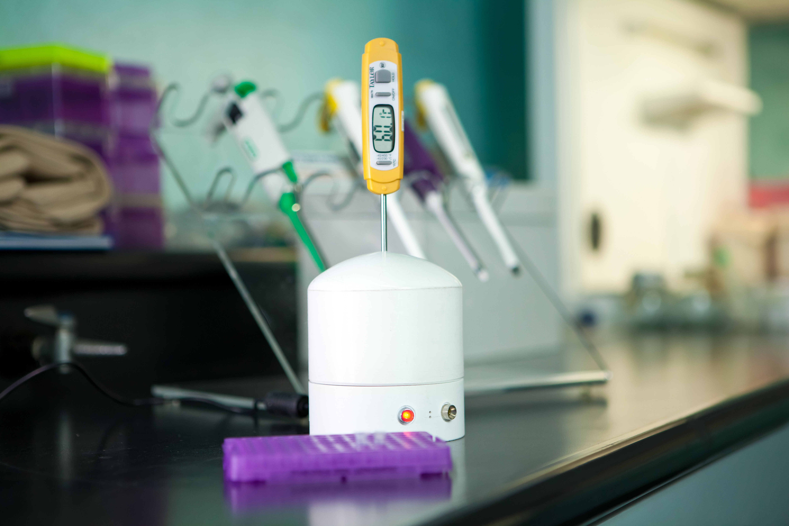
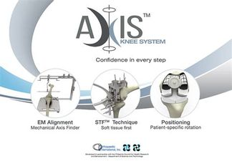
Commercialized Projects
BioTek-M

Slide 101
Summary – Based on my own professional opinion
Engineering Track Training Lacks
Biology Subjects
Physiology related Subjects
Practical Medical Device Design
Clinical Orientation
Issues
Unit Load Limits

Slide 102
Summary - What we have on hand to support Biomedical Research in the Philippines?
Standardized Testing
EPDC
Fabricators
Additive/Deductive Process
Machine Insurance Providers
Medical Insurance Providers for Healthy Test Participants
Third Party Evaluation Facility for Medical Devices

Slide 103
Summary – What we currently lack
Evaluation Facilities for Bio-compatibility
Liability Insurance Provider
Value Engineering Provider with a long history of BME projects
Locally Available Trained Personnel to Handle
Engineers who are oriented to do the Preparation Work for Clinical Studies
Business Incubators with the Manufacturing Ability
Local Standards that make it easier for people to find out what to comply to

